Slide 1
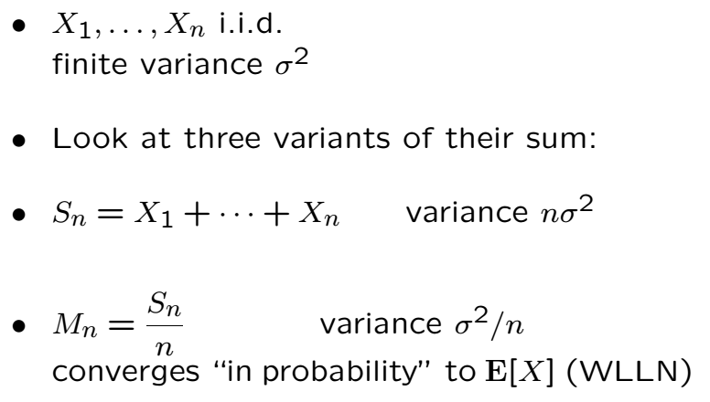
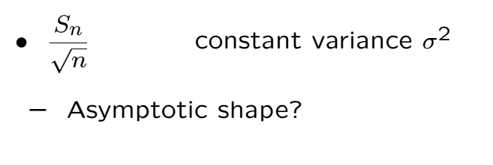
Different Scalings of the Sum

Slide 2
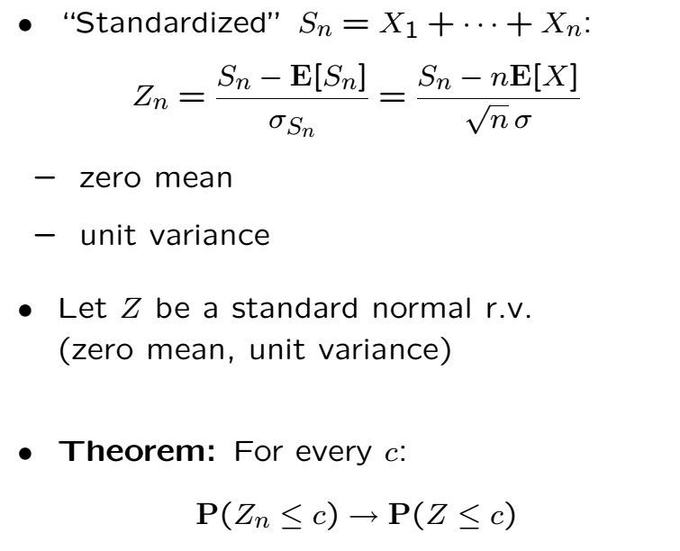
Central Limit Theorem

Slide 3
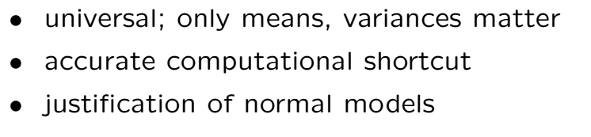
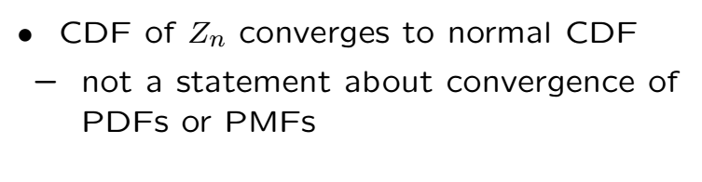
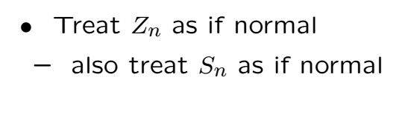
Profundity and Usefulness

Slide 4
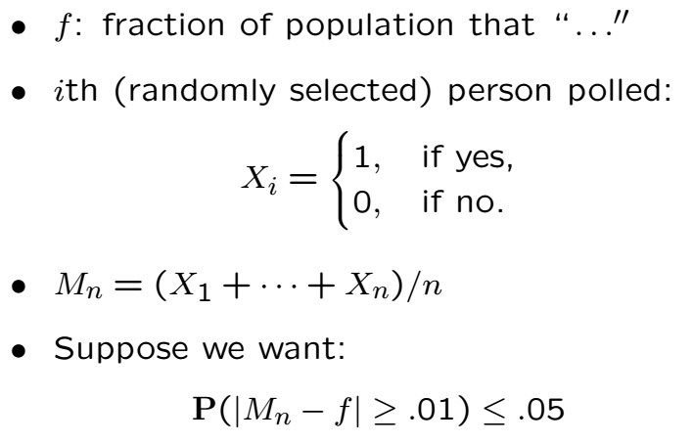
Back to the Polls

Slide 5
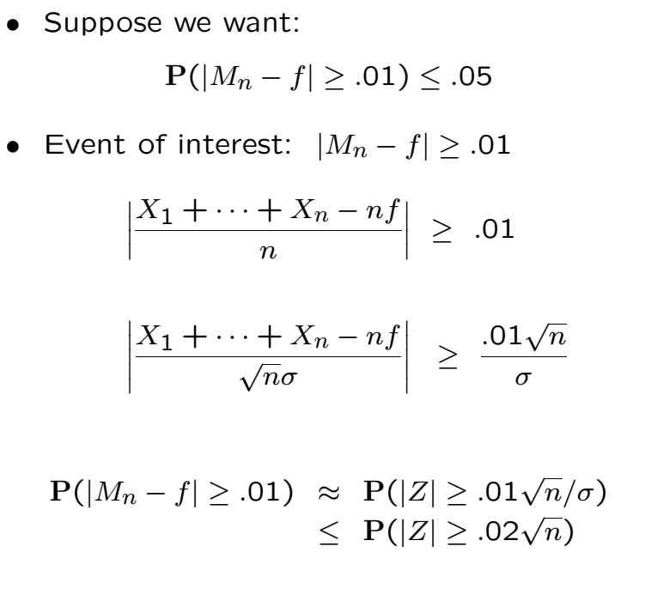
Apply CLT

Slide 6
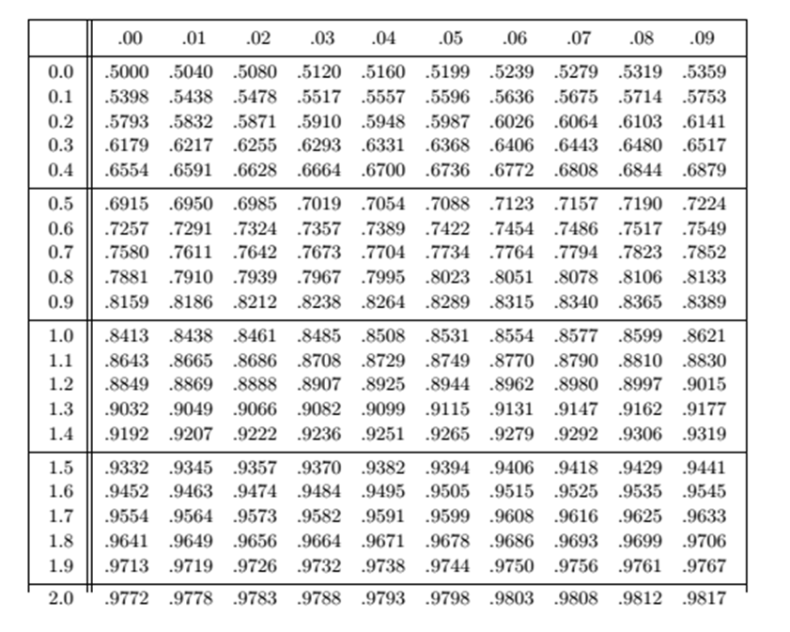
Apply CLT

Slide 8
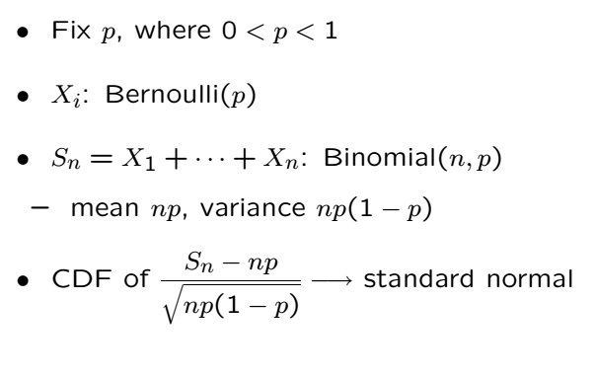
Binomial is a Sum of RVs

Slide 9
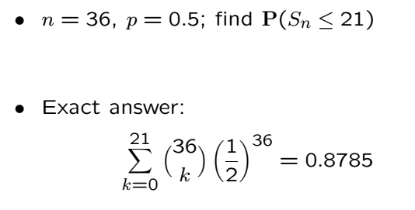
Example

Slide 10
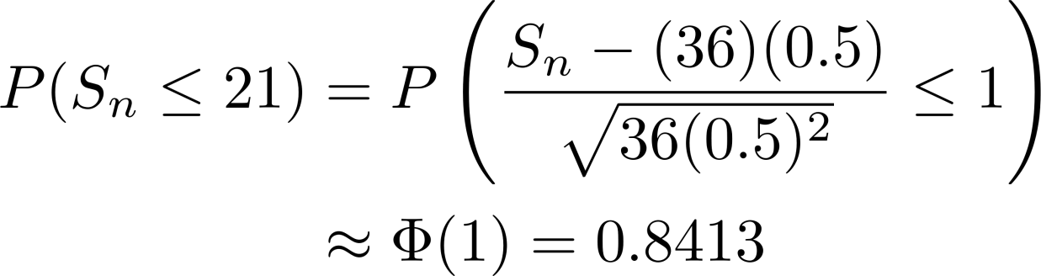
Example Cont’
CLT approximation

Slide 11
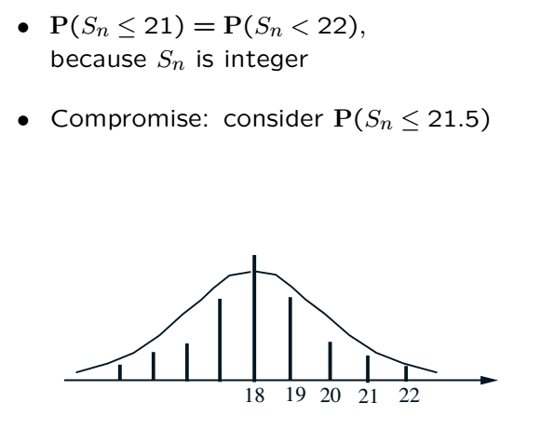

Correction for Binomial Approx.
Changing 21 to 21.5 yields 1 to 1.166, so we lookup

Slide 12
Acknowledgements and Citations
Parts of these slides are adapted from the following resources:
Power Point Lecture Slides for the Textbook http://bcs.wiley.com/hebcs/Books?action=index&bcsId=8676&itemId=1118324560
John Tsitsiklis. 6.041 Probabilistic Systems Analysis and Applied Probability, Fall 2010. (Massachusetts Institute of Technology: MIT OpenCourseWare),http://ocw.mit.edu (Accessed 13 Apr, 2015). License: Creative Commons BY-NC-SA

